Slide 1
Day 4
Inheritance and Abstract; Exception
Jitendra Dubey

Slide 2
Plan of Attack
Inheritance :
Need for Inheritance
Overriding
Super
Types
Abstract:
Need for Abstract
Abstract Method
Assignments: Go To Assignments

Slide 3
Plan of Attack
Exception Handling:
Introducation
Raise
Custom Exceptions
Simulator
Assignments: Go To Assignments

Slide 4
Plan of Attack
Q & A:
Practice Questions
Mock OOP Practice
Practice Quiz
Reference Document

Slide 5
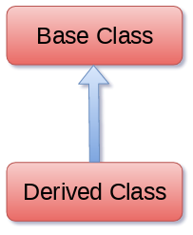
Inheritance
Inheritance is an important aspect of the object-oriented paradigm
In inheritance, the child class acquires the properties and can access all the data members and functions defined in the parent class

Slide 6
Inheritance
class name(superclass):
statements
  Example:
  class Point3D(Point): # Point3D extends Point
  z = 0
  ...
  Need Of Inheritance:
  - It provides reusability of a code.
  - It allows us to add more features to a class without modifying it
  - Easy and Flexibility

Slide 7
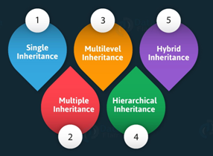
Types of Inheritance

Slide 8
Types of Inheritance
Single inheritance:
When a child class inherits from only one parent class, it is called as single inheritance.
Example:
class Animal:
def speak(self):
print("Animal Speaking")
#child class Dog inherits the base class Animal
class Dog(Animal):
def bark(self):
print("dog barking")
d = Dog()
d.bark()
d.speak()

Slide 9
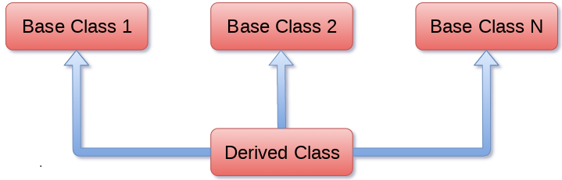
Types of Inheritance
Multiple inheritance:
When a child class inherits from multiple parent classes, it is called as multiple inheritance.
Example:
class Calculation1:
def Summation(self,a,b):
return a+b;
class Calculation2:
def Multiplication(self,a,b):
return a*b;
class Derived(Calculation1,Calculation2):
def Divide(self,a,b):
return a/b;
d = Derived()
print(d.Summation(10,20))
print(d.Multiplication(10,20))
print(d.Divide(10,20))

Slide 10
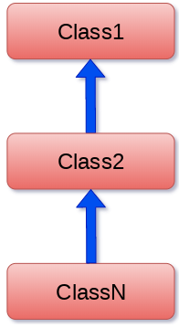
Types of Inheritance
Multilevel inheritance:
When we have child and grand child relationship.
Example:
class Animal:
def speak(self):
print("Animal Speaking")
#The child class Dog inherits the base class Animal
class Dog(Animal):
def bark(self):
print("dog barking")
#The child class Dogchild inherits another child class Dog
class DogChild(Dog):
def eat(self):
print("Eating bread...")
d = DogChild()
d.bark()
d.speak()
d.eat()

Slide 11
Types of Inheritance
Multilevel inheritance:
When we have child and grand child relationship.
Example:
class Animal:
def speak(self):
print("Animal Speaking")
#The child class Dog inherits the base class Animal
class Dog(Animal):
def bark(self):
print("dog barking")
#The child class Dogchild inherits another child class Dog
class DogChild(Dog):
def eat(self):
print("Eating bread...")
d = DogChild()
d.bark()
d.speak()
d.eat()

Slide 12
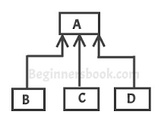
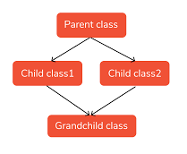
Types of Inheritance
Hierarchical inheritance:
More than one derived classes are
created from a single base.
Hybrid inheritance: This form combines more than one form of inheritance. Basically, it is a blend of more than one type of inheritance.

Slide 13
Types of Inheritance
Hierarchical inheritance:
More than one derived classes are
created from a single base.
Hybrid inheritance: This form combines more than one form of inheritance. Basically, it is a blend of more than one type of inheritance.

Slide 14
Method overriding
method overriding: occurs simply defining in the child class a method with the same name of a method in the parent class.
OR
Override means having two methods with the same name but doing different tasks. It means that one of the methods overrides the other.
class Parent(object):
def __init__(self):
self.value = 5
def get_value(self):
return self.value
class Child(Parent):
def get_value(self):
return self.value + 1
c = Child()
c.get_value()

Slide 15
Super
Super() built-in has two major use cases:
  Allows us to avoid using base class explicitly
Example:
class Mammal(object):
def __init__(self, mammalName):
print(mammalName, 'is a warm-blooded animal.')
class Dog(Mammal):
def __init__(self):
print('Dog has four legs.')
super().__init__('Dog')
d1 = Dog()
Since, we do not need to specify the name of the base class if we use super(), we can easily change the base class for Dog method

Slide 16
Abstract
An abstract class can be considered as a blueprint for other classes, allows you to create a set of methods that must be created within any child classes built from your abstract class.
- A class which contains one or abstract methods is called an abstract class
- An abstract method is a method that has declaration but not has any implementation.
- Abstract classes are not able to instantiated and it needs subclasses to provide implementations for those abstract methods
- When we want to provide a common implemented functionality for all implementations of a component, we use an abstract class

Slide 17
Why & How uses Abstract class
Abstract classes allow you to provide default functionality for the subclasses
In python by default, it is not able to provide abstract classes
python comes up with a module which provides the base for defining Abstract Base classes(ABC) and that module name is ABC
A method becomes an abstract by decorated it with a keyword @abstractmethod.
ABC works by marking methods of the base class as abstract and then registering concrete classes as implementations of the abstract base

Slide 18
Why & How uses Abstract class
Examples:
from abc import ABC, abstractmethod
class Polygon(ABC):
# abstract method
def noofsides(self):
pass
class Triangle(Polygon):
# overriding abstract method
def noofsides(self):
print("I have 3 sides")
R = Triangle()
R.noofsides()

Slide 19
Exception
An exception is an error that happens during execution of a program. When that error occurs.
Python generate an exception that can be handled, which avoids your program to crash.
Why use Exceptions:
- Exceptions are convenient in many ways for handling errors and special conditions in a program.
- When you think that you have a code which can produce an error then you can use exception handling.
- Exception handling is to maintain the normal flow of the application

Slide 20
Some Exception Errors
some common exceptions errors:
IOError
If the file cannot be opened.
ImportError
If python cannot find the module
ValueError
Raised when a built-in operation or function receives an argument that has the
right type but an inappropriate value
KeyboardInterrupt
Raised when the user hits the interrupt key (normally Control-C or Delete)
EOFError
Raised when one of the built-in functions (input() or raw_input()) hits an
end-of-file condition (EOF) without reading any data

Slide 21
Some Exception Errors
Example 1:
# NameError
try:
print(x)
except NameError:
print("Variable x is not defined")
except:
print("Something else went wrong")
Example 2:
# File I/O error
try:
f = open("demofile.txt")
f.write(“I am demo file")
except:
print("Something went wrong when writing to the file")
finally:
f.close()

Slide 22
Raise Exception
The raise statement allows the programmer to force a specific exception to occur.
raise ExceptionType("message")
  useful when the client uses your object improperly
  types: ArithmeticError, AssertionError, IndexError, NameError, SyntaxError, TypeError, ValueError
  Example:
  class BankAccount:
  ...
  def deposit(self, amount):
  if amount < 0:
  raise ValueError("negative amount")
  ...

Slide 23
Custom Exception
  you may need to create custom exceptions that serves your purpose.
  Example:
class UnderAge(Exception):
pass
def verify_age(age):
if int(age) < 18:
raise UnderAge
else:
print('Age: '+str(age))
# main program
verify_age(23) # won't raise exception
verify_age(17) # will raise exception

Slide 24
  >>Thank you
  Github
  https://github.com/dubeyjitendra/PythonTrainingPPTs
  LinkedIn
  https://www.linkedin.com/in/jitendra-dubey/

Slide 25
Q & A
  Reference Document:
  https://www.w3schools.com/python/python_numbers.asp
  https://automatetheboringstuff.com/

